Slide 1
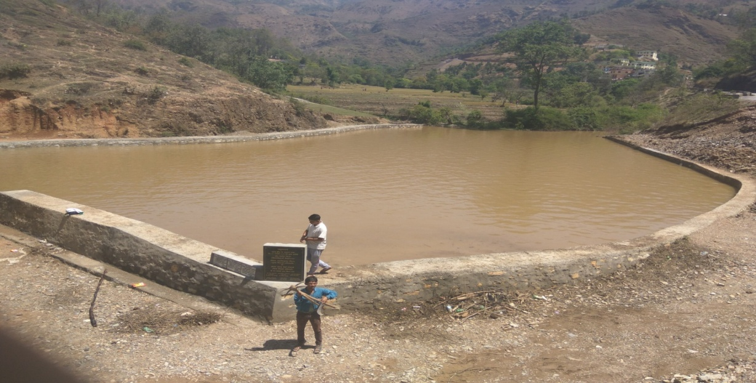
PITHORAGARH
Baralu Jheel…. increased the water level
Baralu village is located in the border of block Munakot, District Pithoragarh, state Uttrakhand. the villagers of baralu were facing the huge problems of one of their daily need that is water, and there are not enough natural resources which met up their requirements, so in Financial year 2016-17 the Project with the name of ‘’Baralu Jheel Nirman “comes into the existence with the help of MGNREGA and it changed the entire scenario.
IMPLEMENTATION
In District Pithoragarh their always problem of water due to lack of natural recourses and peoples are totally depends on rain for their needs, same way villagers of Baralu which are running their livelihood by farming also depends on the same. There are total 201 families resides in the village with total population of 838, among them 84 families are BPL, 51 families are belongs to small farmers, 52 marginal farmers and 14 families belongs to SC all of these families are totally depends on natural resources water bodies which are totally rain allied, So in case if there is short fall in rain they don’t had any option for water supply.

Slide 2
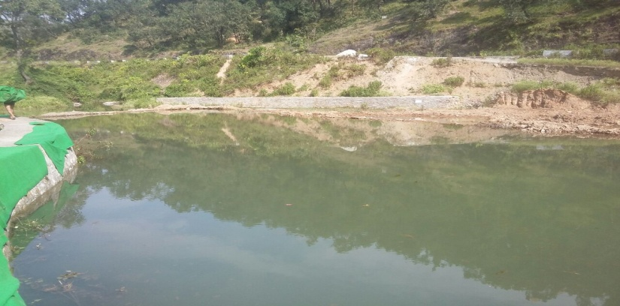
In terms of tourism, the area will also develop with the beauty of lake. The problem of water will be solved to a great extent.
Under MGNREGA total amount of Rs 6 lakhs sanctioned for this project in which 3.66 lakhs are paid in wages in which villagers of baralu got employment along with this they are now getting the proper amount of water to meet up their daily requirement of water for themselves and they use this lake to meet out water requirement of their farming and for their cattle’s.
YEAR - 2016-17
Expenditure - 8.00 lac , (MGNREGS 6.00 Lac., Departmental– 2.00 Lac)
Location G.P.- Baralu, Block- Munakote, District- Pithoragarh
HIGHLIGHTS
Risen in the water level up to 5 to 6 feet despite the low rain fall.
Soil moisture increased, which helps in cultivation and farming
which is directly relates to increase in the incomes of farmers.
Dependency on rain to meet out water requirement is decreased.
IMPACT
With the help of lake, the area is developed in terms of tourism. Peoples from nearby villages come to see the lake and enjoy the natural beauty. Farmers are the most happy among all along with that employment of local traders had increased and new employment opportunities have been developed for the unemployed people. Natural water sources have also increased, the water bodies of the surrounding villages have been revived and the problem of water has been solved to a great extent. After the formation of the lake moisture in the soil increased, and farmers are expecting better production. Lake is working as recharge point for all nearby water bodies.
VOICES FROM THE FIELD
“ I never thought our problems of daily need like water will be solved in great extent, along with that we all farmers are getting the worth of our hard work and I really thanks the government under MGNREGS such good project took place in my village”.
Naveen Joshi , Village-baralu, Block –Munakot, District Pithoragarh

